Slide 1
Lecture 4: Circuit Partitioning – II
Tsung-Wei (TW) Huang
Department of Electrical and Computer Engineering
University of Utah, Salt Lake City, UT

Slide 2
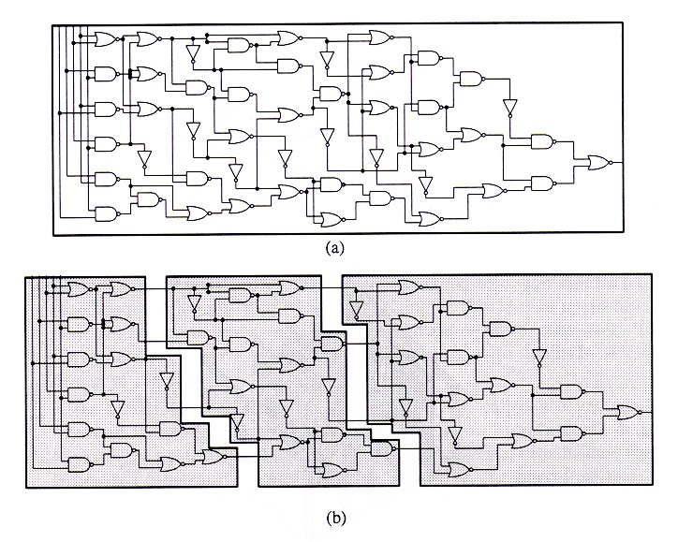
Circuit Partition
An essential step for reducing algorithm design complexity
Divide and conquer (D&C)
Input
A circuit graph
Output
A set of partitioned subgraphs
Objective
Minimize cross-connection

Slide 3
KL Algorithm: Recap
1. Pair-wise exchange of nodes to reduce cut size
2. Allow cut size to increase temporarily within a pass
3. Compute the gain of a swap
Repeat
Perform a feasible swap of max gain
Mark swapped nodes “locked”
Update swap gains
Until no feasible swap
4. Find max prefix partial sum in gain sequence g₁, g₂, …, g_{m}
5. Make corresponding swaps permanent
6. Start another pass if current pass reduces the cut size
u •
v •
v •
u •
locked

Slide 4
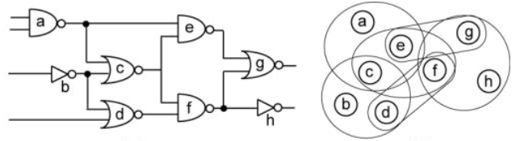
Fiduccia-Mattheyses (FM) Algorithm
Fiduccia and Mattheyses, “A linear time heuristic for improving network partitions,” ACM Design Automation Conference (DAC), 1982

Slide 5
Problem Formulation
Input: A hypergraph with
Set vertices V. (|V| = n)
Set of hyperedges E (total # pins in netlist = p)
Area a_{u} for each vertex u in V
Cost c_{e} for each hyperedge in e
An area ratio r
Output: 2 partitions X & Y such that
Total cost of hyperedges cut is minimized
area(X) / (area(X) + area(Y)) is about r
This problem has been proven to be NP-complete

Slide 6
Ideas of FM Algorithm
Similar to KL:
Work in passes
Lock vertices after moved
Actually, only move those vertices up to the maximum partial sum of gain
Difference from KL:
Not exchanging pairs of vertices
Move only one vertex at each time
The use of gain bucket data structure

Slide 7
Gain Bucket Data Structure
+pmax
Max
Gain
Cell
#
Cell
#
-pmax
1
2
n

Slide 8
FM Partitioning Algorithm
Moves are made based on object gain
Object Gain: The amount of change in cut crossings that will occur if an object is moved from its current partition into the other partition
A pass description
While there is unlocked object
1. Each object is assigned a gain
2. Objects are put into a sorted gain list
3. The object with the highest gain from the larger of the two sides is selected and moved
4. The moved object is "locked"
5. Gains of "touched" objects are recomputed
6. Gain lists are resorted
Repeat the pass until there is no improvement

Slide 9
FM Algorithm Walkthrough – 1
-1
0
2
0
-1
0
-2
0
0
-2
-1
1
-1
1

Slide 10
FM Algorithm Walkthrough – 2
-1
0
2
0
-1
0
-2
0
0
-2
-1
1
-1
1

Slide 11
FM Algorithm Walkthrough – 3
-1
-2
-2
-2
0
-1
-2
0
0
-2
-1
1
-1
1

Slide 12
FM Algorithm Walkthrough – 4
-1
-2
-2
-2
0
-1
-2
0
0
-2
-1
1
1
-1

Slide 13
FM Algorithm Walkthrough – 5
-1
-2
-2
-2
0
-1
-2
0
0
-2
-1
1
1
-1

Slide 14
FM Algorithm Walkthrough – 6
-1
-2
-2
-2
0
-1
-2
0
-2
-2
1
-1
-1
-1

Slide 15
FM Algorithm Walkthrough – 7
-1
-2
-2
-2
0
-1
-2
0
-2
-2
1
-1
-1
-1

Slide 16
FM Algorithm Walkthrough – 8
-1
-2
-2
-2
-1
-2
0
0
-2
-2
1
-1
-1
-1

Slide 17
FM Algorithm Walkthrough – 9
-1
-2
-2
-2
1
-2
0
-2
-2
-2
1
-1
-1
-1

Slide 18
FM Algorithm Walkthrough – 10
-1
-2
-2
-2
1
-2
0
-2
-2
1
-2
-1
-1
-1

Slide 19
FM Algorithm Walkthrough – 11
-1
-2
-2
-2
1
-2
0
-2
-2
1
-2
-1
-1
-1

Slide 20
FM Algorithm Walkthrough – 12
-1
-2
-2
-2
1
-2
0
-2
-1
-2
-2
-3
-1
-1

Slide 21
FM Algorithm Walkthrough – 13
-1
-2
-2
-2
1
-2
0
-2
-1
-2
-2
-3
-1
-1

Slide 22
FM Algorithm Walkthrough – 14
-1
-2
-2
1
-2
-2
0
-2
-1
-2
-2
-3
-1
-1

Slide 23
FM Algorithm Walkthrough – 15
-1
-2
-2
-1
-2
-2
-2
-2
-1
-2
-2
-3
-1
-1

Slide 24
Time Complexity of FM Algorithm
For each pass
Constant time to find the best vertex to move
After each move, time to update gain buckets is proportional to degree of vertex moved
Total time is O(p), where p is total number of pins
Number of passes is usually small
Gain values converge very quickly

Slide 25
Implementation Details
Gain Δg(c) for cell c
Δg(c) = FS(c) – TE(c) ,
where the “moving force“ FS(c) is the number of nets connected to c but not connected to any other cells within c’s partition, i.e., cut nets that connect only to c, and
the “retention force“ TE(c) is the number of uncut nets connected to c.
The higher the gain Δg(c), the higher is the priority to move the cell c to the other partition.
3
2
b
e
a
4
c
1
d
5

Slide 26
Implementation Details (cont’d)
Gain Δg(c) for cell c
Δg(c) = FS(c) – TE(c) ,
where the “moving force“ FS(c) is the number of nets connected to c but not connected to any other cells within c’s partition, i.e., cut nets that connect only to c, and
the “retention force“ TE(c) is the number of uncut nets connected to c.
3
2
b
e
a
4
c
1
d
5
2
3
Cell 1: FS(1) = 2 TE(1) = 1 Δg(1) = 1
Cell 2: FS(2) = 0 TE(2) = 1 Δg(2) = -1
Cell 3: FS(3) = 1 TE(3) = 1 Δg(3) = 0
Cell 4: FS(4) = 1 TE(4) = 1 Δg(4) = 0
Cell 5: FS(5) = 1 TE(5) = 0 Δg(5) = 1
b
e
a
4
c
1
d
5

Slide 27
Maximum Positive Gain
Maximum positive gain G_{m} of a pass
The maximum positive gain G_{m} is the cumulative cell gain of m moves that produce a minimum cut cost.
G_{m} is determined by the maximum sum of cell gains Δg over a prefix of m moves in a pass

Slide 28
Area Ratio Factor
The ratio factor is the relative balance between the two partitions with respect to cell area It is used to prevent all cells from clustering into one partition.
The ratio factor r is defined as
where area(A) and area(B) are the total respective areas of partitions A and B

Slide 29
Balanced Partition
The balance criterion enforces the ratio factor
To ensure feasibility, the maximum cell area area_{max}(V) must be taken into account
A partitioning of V into two partitions A and B is said to be balanced if
[ r ∙ area(V) – area_{max}(V) ] ≤ area(A) ≤ [ r ∙ area(V) + area_{max}(V) ]

Slide 30
Base Cell
A base cell is a cell c that has the greatest cell gain Δg(c) among all free cells, and whose move does not violate the balance criterion.
Base cell
Cell 1: FS(1) = 2 TE(1) = 1 Δg(1) = 1
Cell 2: FS(2) = 0 TE(2) = 1 Δg(2) = -1
Cell 3: FS(3) = 1 TE(3) = 1 Δg(3) = 0
Cell 4: FS(4) = 1 TE(4) = 1 Δg(4) = 0

Slide 31
FM Algorithm (One Pass)
A
2
3
B
Given: Ratio factor r = 0.375
area(Cell_1) = 2 area(Cell_2) = 4 area(Cell_3) = 1 area(Cell_4) = 4 area(Cell_5) = 5.
b
e
a
4
c
d
1
5
Step 0: Compute the balance criterion
[ r ∙ area(V) – area_{max}(V) ] ≤ area(A) ≤ [ r ∙ area(V) + area_{max}(V) ]
0.375 * 16 – 5 = 1 ≤ area(A) ≤ 11 = 0.375 * 16 +5.

Slide 32
FM Algorithm (One Pass)
A
2
3
B
b
e
a
4
c
d
1
5
Step 1: Compute the gains of each cell Cell 1: FS(Cell_1) = 2 TE(Cell_1) = 1 Δg(Cell_1) = 1
Cell 2: FS(Cell_2) = 0 TE(Cell_2) = 1 Δg(Cell_2) = -1
Cell 3: FS(Cell_3) = 1 TE(Cell_3) = 1 Δg(Cell_3) = 0
Cell 4: FS(Cell_4) = 1 TE(Cell_4) = 1 Δg(Cell_4) = 0
Cell 5: FS(Cell_5) = 1 TE(Cell_5) = 0 Δg(Cell_5) = 1

Slide 33
FM Algorithm (One Pass)
A
2
3
B
Cell 1: FS(Cell_1) = 2 TE(Cell_1) = 1 Δg(Cell_1) = 1
Cell 2: FS(Cell_2) = 0 TE(Cell_2) = 1 Δg(Cell_2) = -1
Cell 3: FS(Cell_3) = 1 TE(Cell_3) = 1 Δg(Cell_3) = 0
Cell 4: FS(Cell_4) = 1 TE(Cell_4) = 1 Δg(Cell_4) = 0
Cell 5: FS(Cell_5) = 1 TE(Cell_5) = 0 Δg(Cell_5) = 1
b
e
a
4
c
d
1
5
Step 2: Select the base cell
Possible base cells are Cell 1 and Cell 5
Balance criterion after moving Cell 1: area(A) = area(Cell_2) = 4
Balance criterion after moving Cell 5: area(A) = area(Cell_1) + area(Cell_2) + area(Cell_5) = 11
Both moves respect the balance criterion, but Cell 1 is selected, moved, and fixed as a result of the tie-breaking criterion.

Slide 34
FM Algorithm (One Pass)
A
2
3
B
b
e
a
4
c
d
1
5
Step 3: Fix base cell, update Δg values
Cell 2: FS(Cell_2) = 2 TE(Cell_2) = 0 Δg(Cell_2) = 2
Cell 3: FS(Cell_3) = 0 TE(Cell_3) = 1 Δg(Cell_3) = -1
Cell 4: FS(Cell_4) = 0 TE(Cell_4) = 2 Δg(Cell_4) = -2
Cell 5: FS(Cell_5) = 0 TE(Cell_5) = 1 Δg(Cell_5) = -1
After Iteration i = 1: Partition A₁ = {2}, Partition B₁ = {1,3,4,5}, with fixed cell {1}.

Slide 35
FM Algorithm (One Pass)
A
2
3
B
Lock Cell 1
b
e
Cell 2: FS(Cell_2) = 2 TE(Cell_2) = 0 Δg(Cell_2) = 2
Cell 3: FS(Cell_3) = 0 TE(Cell_3) = 1 Δg(Cell_3) = -1
Cell 4: FS(Cell_4) = 0 TE(Cell_4) = 2 Δg(Cell_4) = -2
Cell 5: FS(Cell_5) = 0 TE(Cell_5) = 1 Δg(Cell_5) = -1
a
4
c
d
1
5
Next iteration …
Cell 2 has maximum gain Δg₂ = 2, area(A) = 0, balance criterion is violated.
Cell 3 has next maximum gain Δg₂ = -1, area(A) = 5, balance criterion is met.
Cell 5 has next maximum gain Δg₂= -1, area(A) = 9, balance criterion is met.
Move cell 3, updated partitions: A₂ = {2,3}, B₂ = {1,4,5}, with fixed cells {1,3}

Slide 36
FM Algorithm (One Pass)
A
2
3
Lock Cell 1 and Cell 3
e
Cell 2: Δg(Cell_2) = 1
Cell 4: Δg(Cell_4) = 0
Cell 5: Δg(Cell_5) = -1
a
b
B
4
c
d
1
5
Next iteration …
Cell 2 has maximum gain Δg₃ = 1, area(A) = 1, balance criterion is met. Move cell 2, updated partitions: A₃ = {3}, B₃ = {1,2,4,5}, with fixed cells {1,2,3}

Slide 37
FM Algorithm (One Pass)
B
2
3
A
Lock Cell 1, Cell 3, and Cell 2
e
a
b
4
Cell 4: Δg(Cell_4) = 0
Cell 5: Δg(Cell_5) = -1
c
d
1
5
Next iteration …
Cell 4 has maximum gain Δg₄ = 0, area(A) = 5, balance criterion is met. Move cell 4, updated partitions: A₄ = {3,4}, B₃ = {1,2,5}, with fixed cells {1,2,3,4}

Slide 38
FM Algorithm (One Pass)
B
2
3
A
Lock Cell 1, Cell 3, Cell 2, and Cell 4
e
a
b
4
Cell 5: Δg(Cell_5) = -1
c
d
1
5
Next iteration …
Cell 5 has maximum gain Δg₅ = -1, area(A) = 10, balance criterion is met. Move cell 5, updated partitions: A₄ = {3,4,5}, B₃ = {1,2}, all cells {1,2,3,4,5} fixed.

Slide 39
FM Algorithm (One Pass)
B
2
3
A
End of each pass: find best move sequence c₁ … c_{m}
G₁ = Δg₁ = 1 G₂ = Δg₁ + Δg₂ = 0 G₃ = Δg₁ + Δg₂ + Δg₃ = 1 G₄ = Δg₁ + Δg₂ + Δg₃ + Δg₄ = 1 G₅ = Δg₁ + Δg₂ + Δg₃ + Δg₄ + Δg₅ = 0.
e
a
b
4
c
d
1
5
found in iterations 1, 3 and 4.
The move prefix m = 4 is selected due to the better balance ratio (area(A) = 5); the four cells 1, 2, 3 and 4 are then moved.
Result of Pass 1: Current partitions: A = {3,4}, B = {1,2,5}, cut cost reduced from 3 to 2.
Maximum positive cumulative gain

Slide 40
Programming Assignment #1
Implement FM partitioning algorithm
ff
Two checkpoint dues
ff
Presentation

